Slide 1
Redistribution for Equitable Growth
What are the alternatives?

Slide 2
Readings
Keith Griffin(1989): Chapter 7 from Alternative Strategies for Economic Development
(copy provided in class)
Suggested Reading:
Keith Grifin, Aziz Khan and Amy Ickowitz(2002): Poverty and Distribution of Land
Journal of Agrarian Change

Slide 3
Why Redistribution?
Entitlement or command over goods and services are determined primarily by the endowment of an agent
Exchange possibility is the other determinant
Redistribution is the surest means to enhance this endowment for the poor
What are the alternative models of redistribution?

Slide 4
Redistribution on the margin
Idea popularised by the World Bank in the mid-1970s(Chenery et. al. Redistribution with Growth)
The core of the strategy is redistribution of the benefits of growth
In other words, growth is still generated by the autonomous movement of the economy but its dividends are shared (to some extent)
Different from involving the poor in the process generating growth
The tax-transfer mechanism is the main instrument for implementing this strategy

Slide 5
Different ways of redistributing growth
Consumption redistribution: A certain percentage of income or (incremental income) is transferred directly to the poor. The World Bank proposed a target of 2 percent of the GDP
Investment redistribution: A certain percentage of income is invested in projects directly affecting the poor
Possibility of a third model (perverse redistribution) : Restrict wage levels in order to boost profit and investment and eventually rates of growth. Distribution moves against the poor

Slide 6
Comparing the different models (based on simulation exercises)
In case of consumption transfers( 2 percent of the GDP annually for 25 years), there was a huge opportunity cost in terms of lost growth( which could have materialised from investments instead of consumption)
As soon as consumption transfers ceased the per capita consumption of the poor decreased
Eventually after 40 years the consumption levels of the poor was 19 percent lower that it would have been without the transfer
In case of investment transfers( 2 percent of GDP annually for 25 years), the consumption levels of the poor increased 23 percent after 40 years in contrast to what it would have been without the transfer
However, the immediate impact on poverty was lower in this case

Slide 7
Some general problems with the redistribution with growth strategy
First it is difficult to make the process viable politically for a sustained period (constant pressure from the rich to discontinue)
There are definite losses for the non –poor sections from this policy (for the middle class consumption falls 19 percent and 17 percent for the higher income group after 40 years)
Problem of efficient targeting and preventing leakage. Also the differential impact on different groups of the poor
Given the initial distribution of assets among the different classes, redistribution at the margin may not be successful in the long run to alter income distribution radically. There are countervailing market forces which might neutralise some of the positive impact

Slide 8
Redistribution of Assets
Changing the initial distribution of endowments
Most often discussed in the context of land reform
Ex-ante redistibution of productive assets make poorer sections participate more in the growth process and benefit from it
One time redistribution which is difficult to bring about but does not need sustaining
Of course with regressive regimes land redistribution has been overturned as well
Successful land reforms have been credited with providing the basis for equitable growth in Japan, South Korea and Taiwan

Slide 9
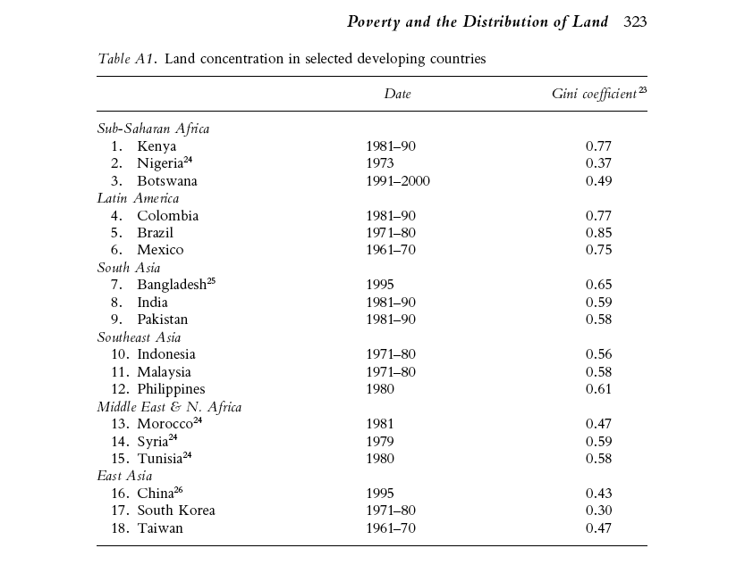

Slide 10
How does land reform help?
Land reform breaks the system of dominance of the land owners which is based on land concentration
It improves wealth distribution as well as income distribution
Combining the efficiency and equity impacts on income( average income increases due to the inverse relationship between farm size and productivity as well as incentive effects and distribution of income improves due to redistribution of productive assets) income poverty is bound to decrease
There are major non-economic benefits of land reform as well (e.g. breakdown of social hierarchies which are based on economic dominance, end of political clout of the landowning class)

Slide 11
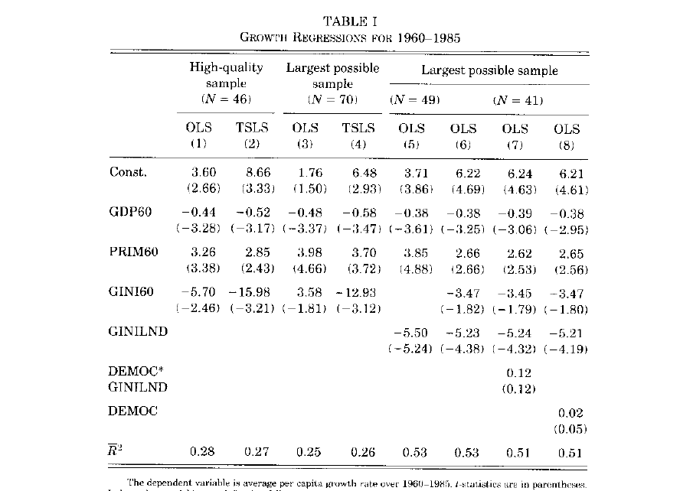

Slide 12
How does land reform relate to inclusive development
It brings about equitable asset distribution in agriculture which involves some of the poorest sections in the economy
As long as it is complemented with suitable policies it can lead to agricultural growth which is broad based leading to a more equitable distribution of income
Unless the subsequent industrial development is particularly disequalising, the growth process built on a relatively equal distribution will yield more inclusive outcomes
The difference between South Korea, Taiwan on the one hand and China on the other

Slide 13
Limits of land reform
Land reform is not simply a policy option
Most successful land reforms are the result of revolutionary changes or particular circumstances
It is therefore difficult to replicate these successes
Moreover, severe inter-generational fragmentation has made average land sizes very small and potentially unviable
In the present bout of crisis facing agriculture, is it possible to implement radical land reform and still stimulate production?

